Slide 1
Smart Meeting System to Control Attendances in Events
Smart Team:
Andrew Trinidad
Caique Bispo Ferreira
Scarbourogh, December 2019

Slide 2
Smart Meeting System to Control Attendences in Events
Design Patterns
Class Diagrams with the design pattens
UI Mock-ups
Component Diagram
Deployment Diagram
Conclusion
Q & A

Slide 3
Design Pattens

Slide 4
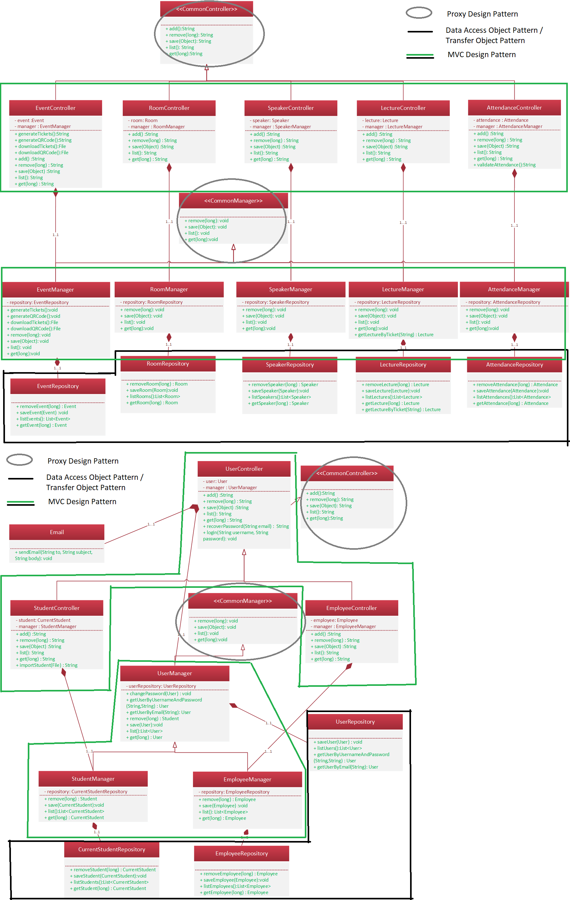
Class Diagrams

Slide 5
Class Diagrams

Slide 6
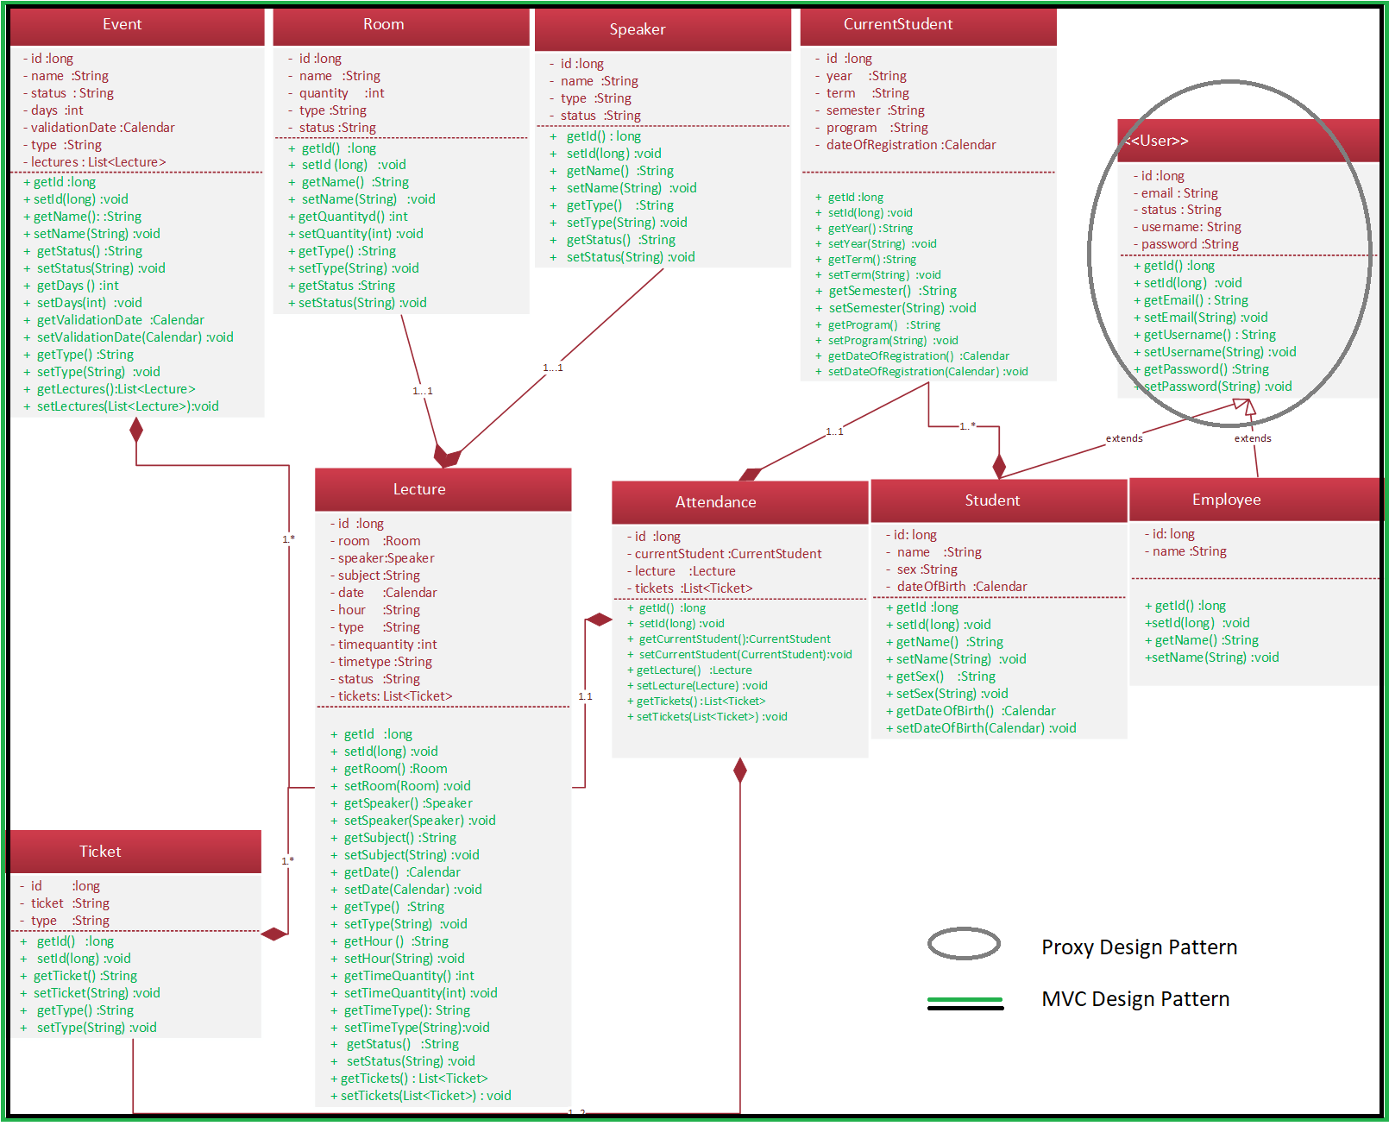
Class Diagrams

Slide 7
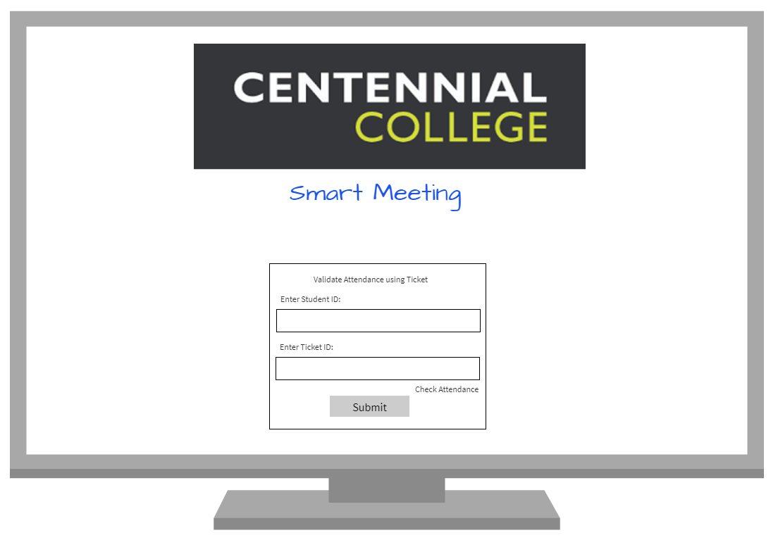
Mock-ups

Slide 8
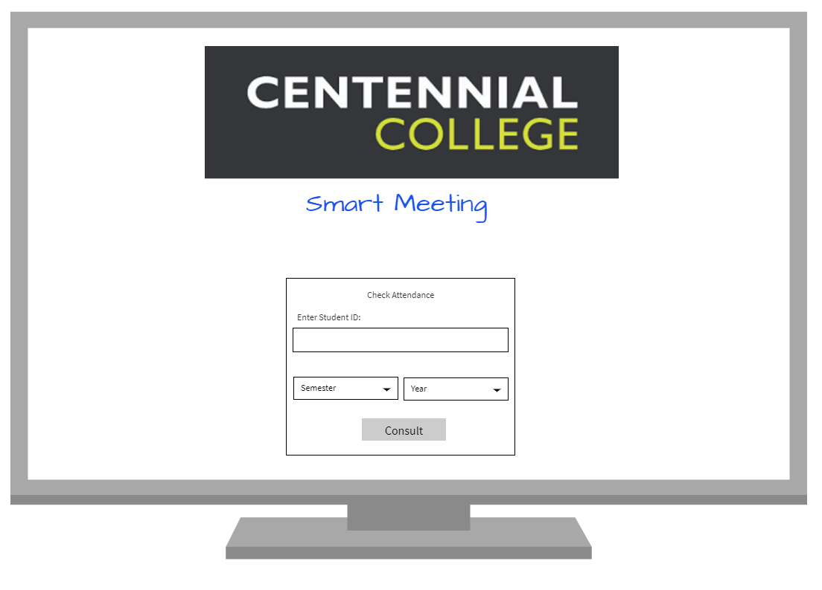
Mock-ups

Slide 9
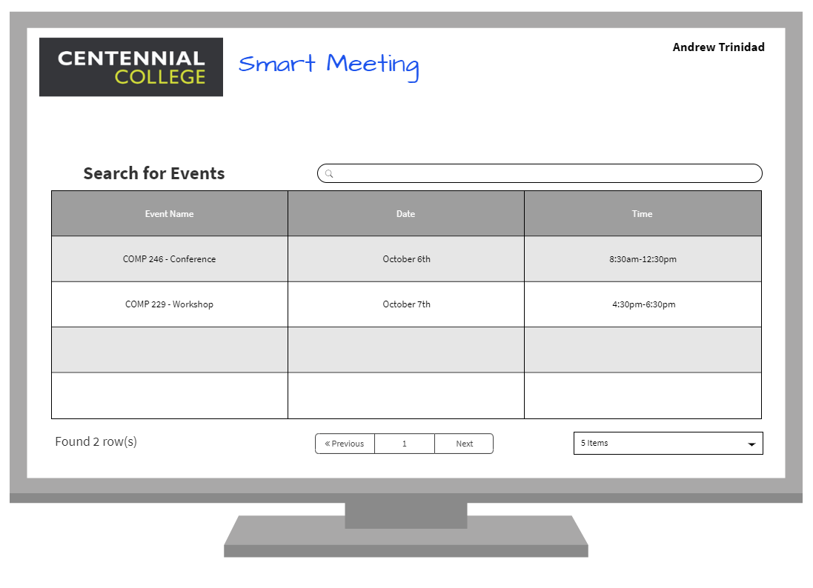
Mock-ups

Slide 10
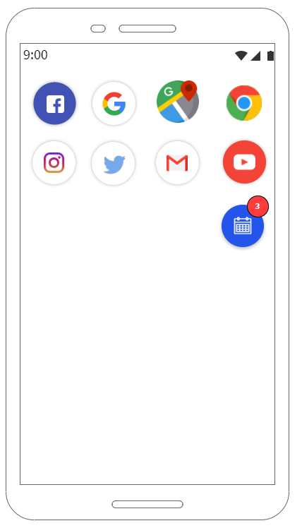
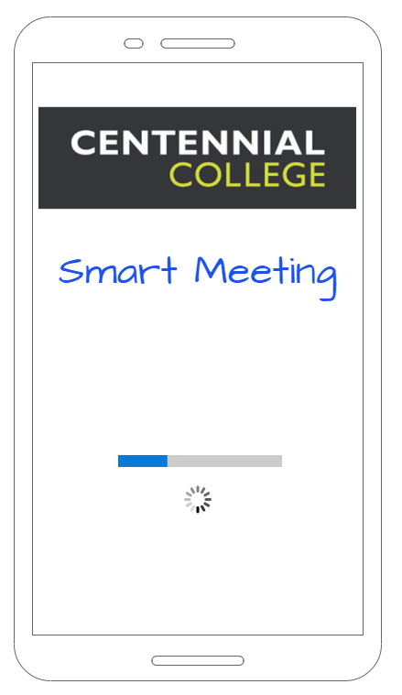
Mock-ups

Slide 11
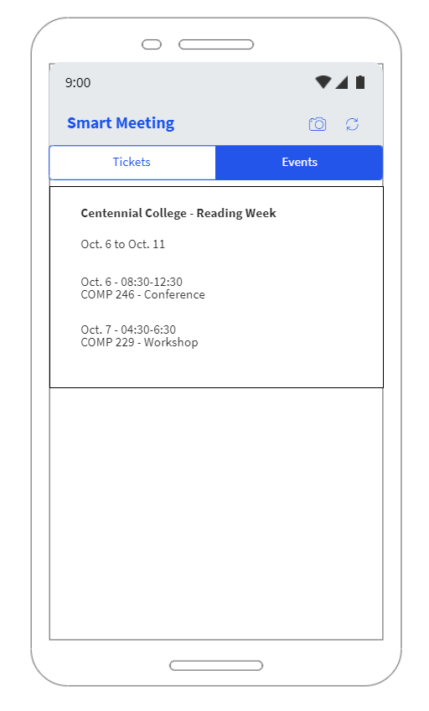
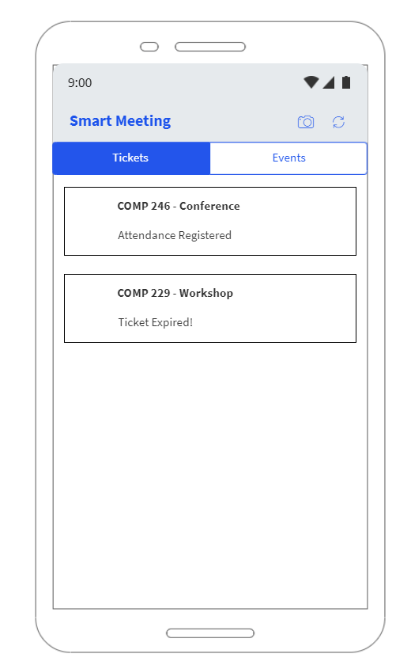
Mock-ups

Slide 12
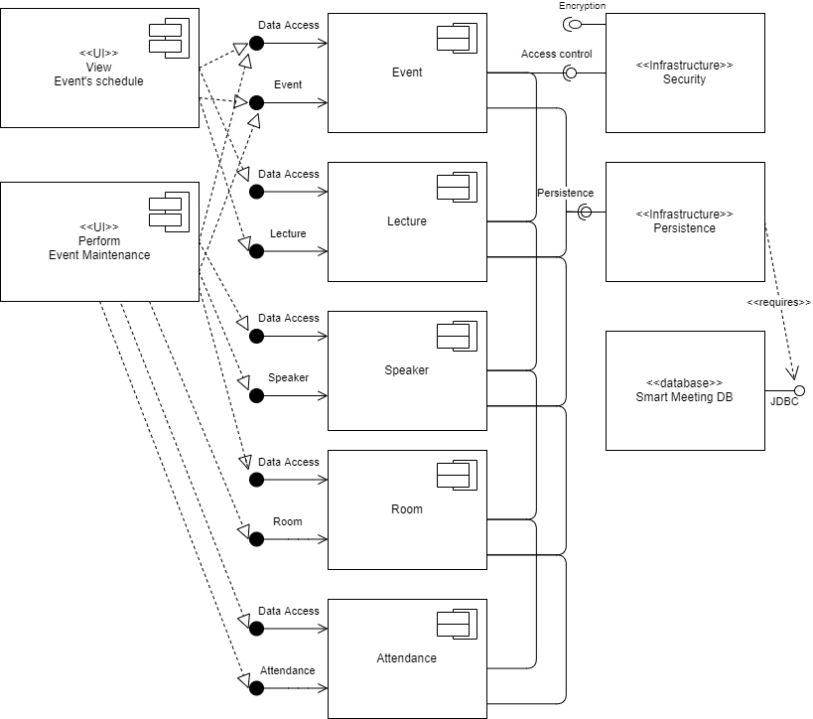
Component Diagram

Slide 13
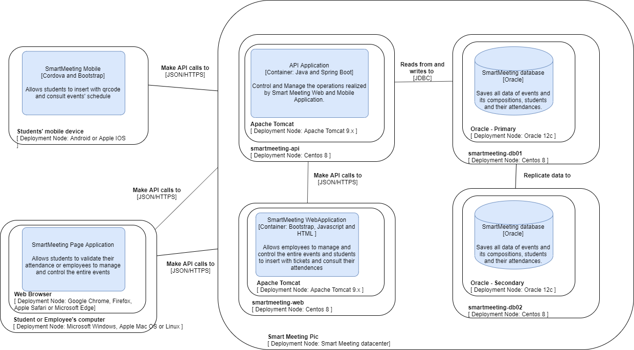
Deployment Diagram

Slide 14
Conclusion
Knowledge enhancement in architecture and development of distributed solutions
Time management challenge and task prioritization
Autonomy of members in performing tasks
Development of a solution for an underexplored niche market

Slide 15

Q & A

Slide 16

Thank you!

